Slide 1


Comparison of Strategies for Scalable Causal Discovery of Latent Variable Models from Mixed Data
Vineet Raghu, Joseph D. Ramsey, Alison Morris, Dimitrios V. Manatakis, Peter Spirtes, Panos K. Chrysanthis, Clark Glymour, and Panayiotis V. Benos

Slide 2
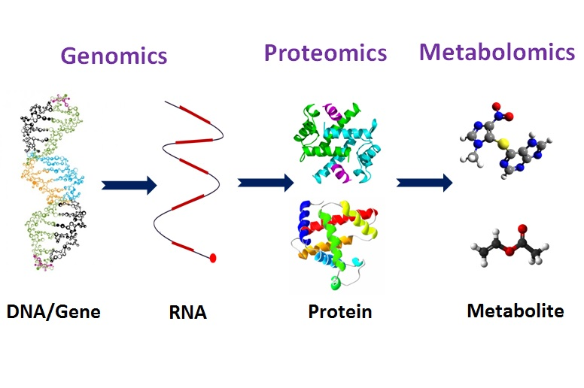

Integrated Biomedical Data
Integrated Dataset
Notes:
The challenge we are addressing is integrated biomedical data, stemming from combined clinical measurements with omics data. This is useful in cases of patient stratification (separate treatment groups based on patient history or genetic factors) and in mechanistic analysis: why are patients x, y, and z likely to get breast cancer? What is the biological mechanism for this likelihood?

Slide 3
Useful Knowledge Requires Causality
Patient Stratification
Mechanistic Analysis
Without causal understanding of gene-phenotype relationships
we will not know why treatment plans are working for particular patients
Can lead to problems if these conditions change
Predicting biological mechanisms
inherently requires causal knowledge

Slide 4
Properties of this Integrated Dataset
Low sample size
Often in the hundreds
Many variables
~20,000 genes in the human genome
Integrated Dataset
Latent confounding
Mixed Data
Continuous expression variables and categorical clinical variables

Slide 5
Today’s Talk
Present new strategies for causal discovery on integrated datasets
Provide a comparison of the benefits of each of the tested approaches on simulated data
Apply one good performing strategy to a real biomedical dataset

Slide 6
Fast Causal Inference (FCI)
Sound and complete algorithm for causal structure learning in the presence of confounding
Five major phases
  Adjacency Search (Akin to PC)
  Orient Unshielded Colliders
  Possible D-SEP to further eliminate adjacencies
  Re-Orient colliders with new adjacencies
  Make final orientations based on other constraints
Notes:
The phases in bold we will focus on in this talk

Slide 7
Collider Orientation
Orient triple (“A-C-B”) as a collider if C is not in the set that separates A and B
How do we identify the separating set for a pair of variables?
A
B
C

Slide 8
Prior Strategies
FCI and FCI-Stable
  Use the smallest separating set found (fewest number of variables) as the true separating set
Conservative FCI (CFCI)
  Only orient as a collider if ALL separating sets do not contain the middle variable
Majority Rule FCI
  Use all possible separating sets and take majority vote as to whether a collider should be oriented
Notes:
CFCI -> If none of the sets contain the middle variable, then orient as a definite non collider, otherwise mark the triple as unfaithful or ambiguous

Slide 9
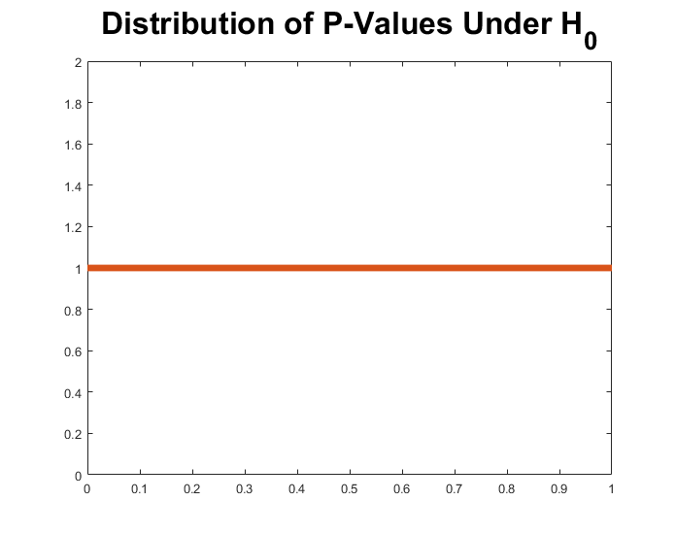
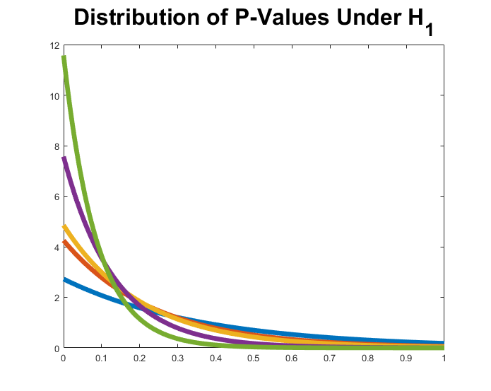
MAX Strategy
Choose the separating set that has the maximum p-value in its conditional independence test
Notes:
Intuitively, we can see that large p-value should be unlikely if the alternative hypothesis of dependence is true
Requires testing of all possible subsets of the adjacencies of the variables involved in the collider

Slide 10
Constraining the Adjacency Search
Use undirected graph learning method to quickly eliminate unlikely adjacencies
Prevents necessity of full adjacency search
Retains asymptotic correctness iff learned undirected graph is a superset of the true adjacencies
Notes:
Now we’ll look at constraining the adjacency search, and we’ll do this with a method to learn a constraining input graph (via undirected graph search)

Slide 11
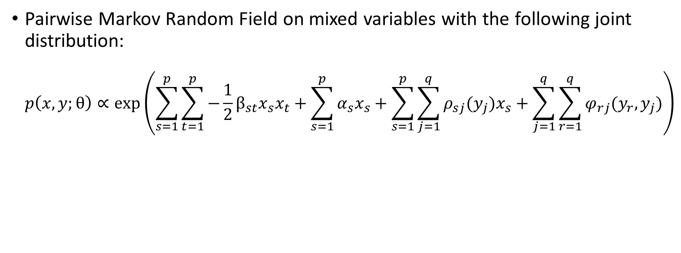
Mixed Graphical Models (MGM)
Pairwise Markov Random Field on mixed variables with the following joint distribution:
$p\left(x,y;θ\right)∝exp⁡\left(\sum_{s=1}^{p}{\sum_{t=1}^{p}{−\frac{1}{2}β_{st}x_{s}x_{t}}+\sum_{s=1}^{p}{α_{s}x_{s}}+\sum_{s=1}^{p}{\sum_{j=1}^{q}{ρ_{sj}(y_{j})x_{s}}}+\sum_{j=1}^{q}{\sum_{r=1}^{q}{φ_{rj}(y_{r},y_{j})}}}\right)$
Continuous-Continuous Edge Potential
Source: Lee and Hastie. Learning the Structure of Mixed Graphical Models. 2013.
Journal of Computational and Graphical Statistics

Slide 12
Mixed Graphical Models (MGM)
Pairwise Markov Random Field on mixed variables with the following joint distribution:
$p\left(x,y;θ\right)∝exp⁡\left(\sum_{s=1}^{p}{\sum_{t=1}^{p}{−\frac{1}{2}β_{st}x_{s}x_{t}}+\sum_{s=1}^{p}{α_{s}x_{s}}+\sum_{s=1}^{p}{\sum_{j=1}^{q}{ρ_{sj}(y_{j})x_{s}}}+\sum_{j=1}^{q}{\sum_{r=1}^{q}{φ_{rj}(y_{r},y_{j})}}}\right)$
Continuous Node Potential
Source: Lee and Hastie. Learning the Structure of Mixed Graphical Models. 2013.
Journal of Computational and Graphical Statistics

Slide 13
Mixed Graphical Models (MGM)
Pairwise Markov Random Field on mixed variables with the following joint distribution:
$p\left(x,y;θ\right)∝exp⁡\left(\sum_{s=1}^{p}{\sum_{t=1}^{p}{−\frac{1}{2}β_{st}x_{s}x_{t}}+\sum_{s=1}^{p}{α_{s}x_{s}}+\sum_{s=1}^{p}{\sum_{j=1}^{q}{ρ_{sj}(y_{j})x_{s}}}+\sum_{j=1}^{q}{\sum_{r=1}^{q}{φ_{rj}(y_{r},y_{j})}}}\right)$
Continuous-Discrete Edge Potential
Source: Lee and Hastie. Learning the Structure of Mixed Graphical Models. 2013.
Journal of Computational and Graphical Statistics

Slide 14
Mixed Graphical Models (MGM)
Pairwise Markov Random Field on mixed variables with the following joint distribution:
$p\left(x,y;θ\right)∝exp⁡\left(\sum_{s=1}^{p}{\sum_{t=1}^{p}{−\frac{1}{2}β_{st}x_{s}x_{t}}+\sum_{s=1}^{p}{α_{s}x_{s}}+\sum_{s=1}^{p}{\sum_{j=1}^{q}{ρ_{sj}(y_{j})x_{s}}}+\sum_{j=1}^{q}{\sum_{r=1}^{q}{φ_{rj}(y_{r},y_{j})}}}\right)$
Discrete-Discrete Edge Potential
Source: Lee and Hastie. Learning the Structure of Mixed Graphical Models. 2013.
Journal of Computational and Graphical Statistics

Slide 15
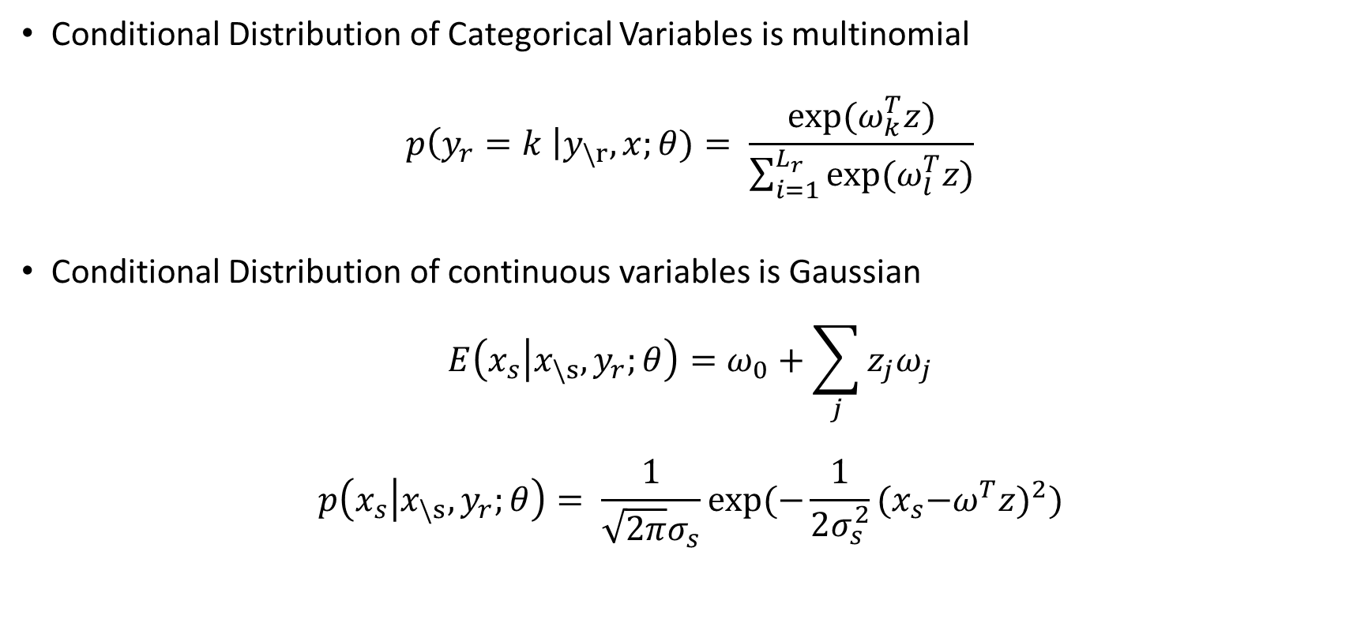
MGM Conditional Distributions
Conditional Distribution of Categorical Variables is multinomial
$$p\left(y_{r}=k \right|y_{\backslash r},x;θ)= \frac{exp⁡(ω_{k}^{T}z)}{\sum_{i=1}^{L_{r}}{exp⁡(ω_{l}^{T}z)}}$$
Conditional Distribution of continuous variables is Gaussian
$$E\left(x_{s} | x_{\backslash s},y_{r};θ\right)=ω_{0}+\sum_{j}{z_{j}ω_{j}}$$
$$p\left(x_{s} | x_{\backslash s},y_{r};θ\right)= \frac{1}{\sqrt{2π}σ_{s}}exp⁡(−\frac{1}{2σ_{s}^{2}}{{(x}_{s}−ω^{T}z)}^{2})$$
Notes:
All of the Z variables are done with dummy coding (zj for categorical variables are just 0-1 indicators for each value of the categorical variable)

Slide 16
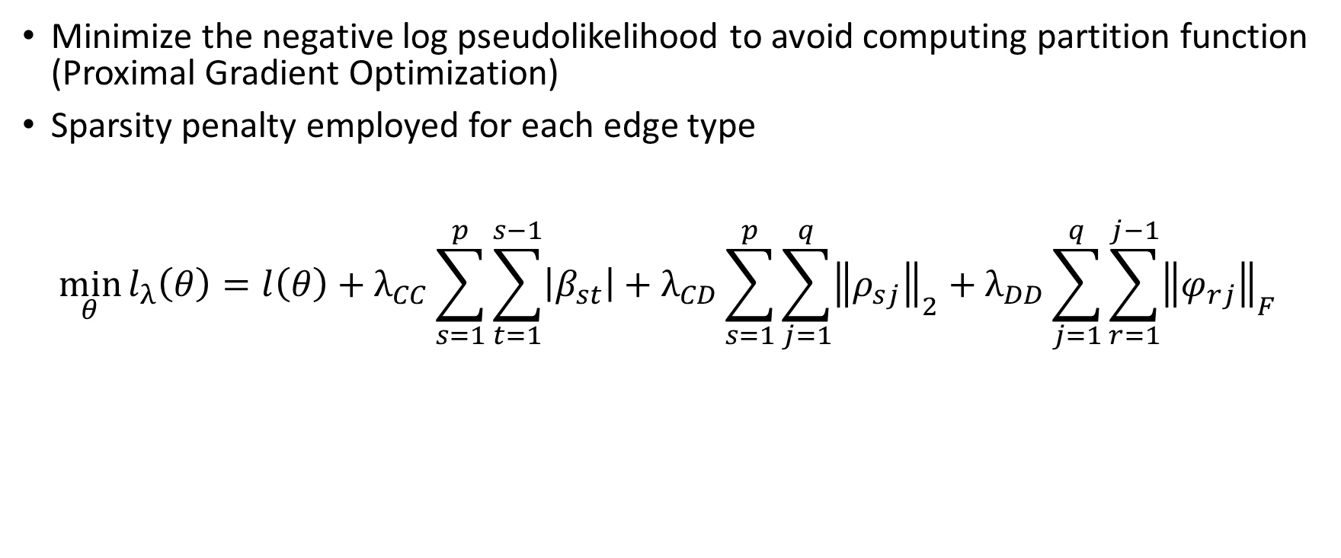
Learning an MGM
Minimize the negative log pseudolikelihood to avoid computing partition function (Proximal Gradient Optimization)
Sparsity penalty employed for each edge type
$$\min_{θ}{l_{λ}\left(θ\right)=l\left(θ\right)+λ_{CC}\sum_{s=1}^{p}{\sum_{t=1}^{s−1}{\left|β_{st}\right|}+λ_{CD}\sum_{s=1}^{p}{\sum_{j=1}^{q}{{\left\|ρ_{sj}\right\|}_{2}}}}+λ_{DD}\sum_{j=1}^{q}{\sum_{r=1}^{j−1}{{\left\|φ_{rj}\right\|}_{F}}}}$$
Source: Sedgewick et al. Learning Mixed Graphical Models with Separate Sparsity Parameters and Stability Based
Model Selection. 2016. BMC Bioinformatics.
Notes:
Explain each edge type and point out norms used

Slide 17
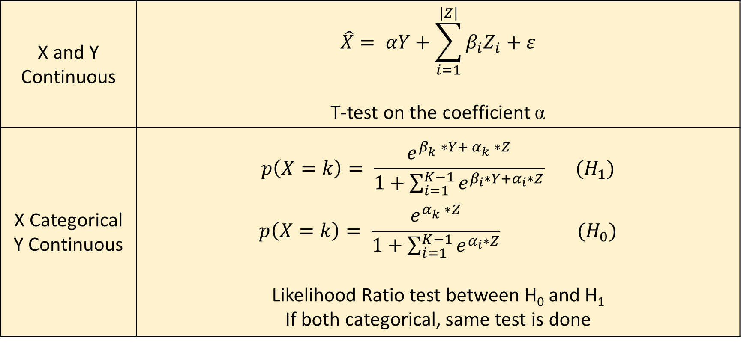
Independence Test (X ⫫ Y | Z)
X and Y Continuous | $$\hat{X}= αY+\sum_{i=1}^{\left|Z\right|}{β_{i}Z_{i}}+ε$$ T-test on the coefficient α
X Categorical Y Continuous | $$p\left(X=k\right)= \frac{e^{β_{k}^{}∗Y+ α_{k}^{}∗Z}}{1+\sum_{i=1}^{K−1}{e^{β_{i}∗Y+α_{i}∗Z}}} (H_{1})$$ $$p\left(X=k\right)= \frac{e^{α_{k}^{}∗Z}}{1+\sum_{i=1}^{K−1}{e^{α_{i}∗Z}}} (H_{0})$$ Likelihood Ratio test between H₀ and H₁ If both categorical, same test is done
Source: Sedgewick, et al. (2016) Mixed Graphical Models for Causal Analysis of Multimodal Variables. arXiv.

Slide 18
Experiments

Slide 19
Competitors and Output Metrics
Competitors
  FCI-Stable (FCI)
  Conservative-FCI (CFCI)
  FCI with the MAX Strategy (FCI-MAX)
  MGM with the above algorithms
  Bayesian Constraint-Based Causal Discovery (BCCD)
Output Metrics
  Precision and Recall for PAG Adjacencies and Orientations
  Running time of the algorithms

Slide 20
Comparing Partial Ancestral Graphs
 | Predicted: A *-o B | Predicted: A *-> B | Predicted A *-- B
True Edge: A *-o B | 1 TP | If(~Ancestor(B,A) 1 TP Else, 1 FN | If (Ancestor(B,A)) 1 TP Else, 1 FP
True Edge: A *-> B | ½ FP | 1 TP | 1 FP
True Edge: A *--B | ½ FN | 1 FN | 1 TP
Comparison of edges only appearing in both the estimated and true graphs
Notes:
Improve upon structural hamming distance by evaluating endpoint meaning
TP if correct endpoint meaning compared to true PAG or to underlying DAG if the PAG is not invariant
FP if claim of ancestry is wrong
FN if claim of non-ancestry is wrong

Slide 21
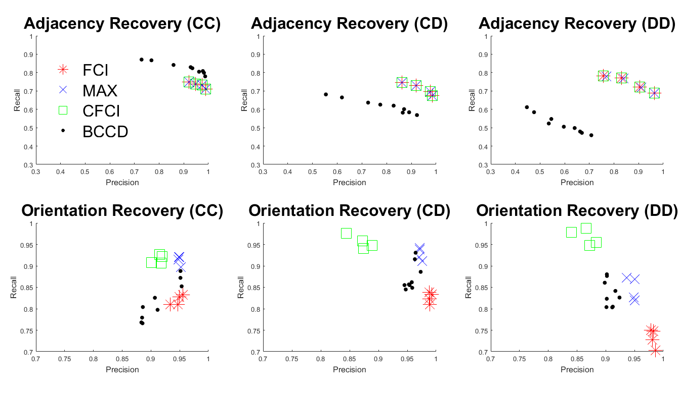
50 Variables, 1000 Samples
Take Away
FCI-MAX improves orientations over all other approaches
BCCD has the best adjacencies on Continuous data, but the FCI approaches perform better with mixed data
Notes:
No MGM algorithms

Slide 22
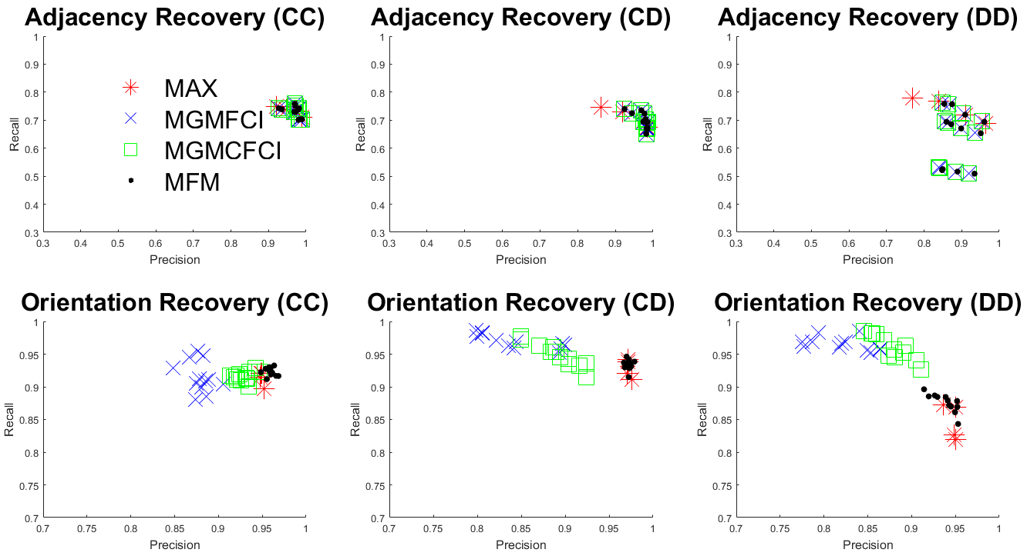
50 Variables, 1000 Samples
Take Away
MGM-FCI-MAX provides slight orientation advantage over FCI-MAX alone
Both approaches perform better than MGM-CFCI and MGM-FCI, though these methods can provide better recall

Slide 23
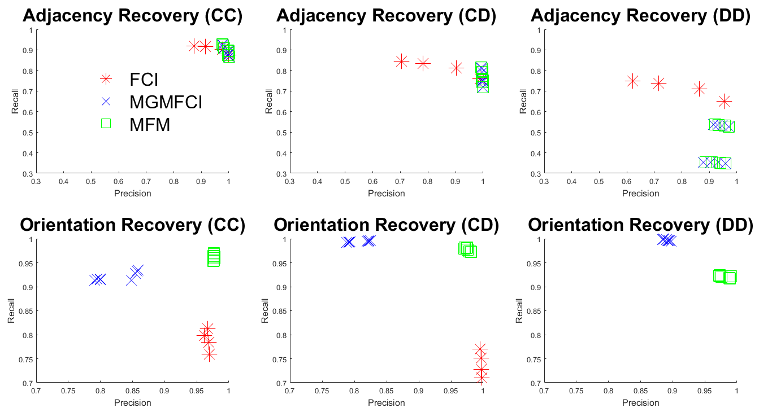
500 Variables, 500 Samples
Take Away
Of the methods that can scale to 500 variables, MFM has the best orientations
FCI maintains an advantage in recall with DD edges but this is parameter dependent

Slide 24
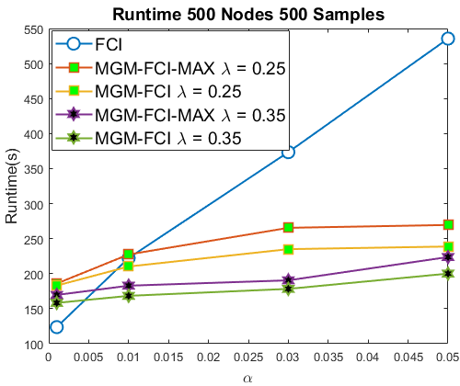
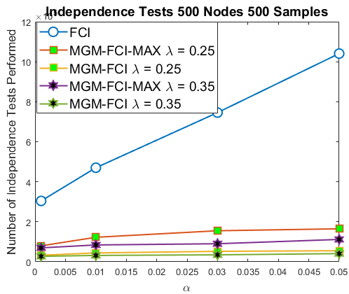
Algorithmic Efficiency 500 Nodes

Slide 25
Biomedical Dataset
Goal: Study the effect of HIV on Lung function decline
Variables: Lung function status, smoking history, patient history, demographics and other clinical information for 933 individuals, half with HIV
Filtered low variance variables and samples with missing data for a final dataset of 14 Continuous Variables, 29 Categorical, and 424 samples

Slide 26
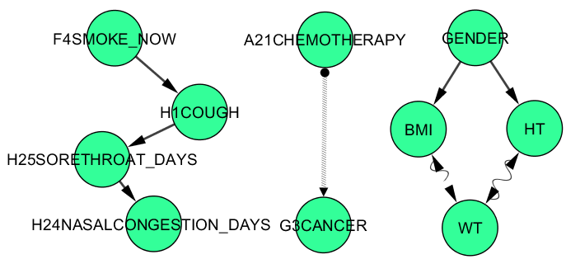
Biologically Validated Edges
Notes:
Currently smoking causing presence of cough, causing sore throat and nasal congestion
Chemo and Cancer are clearly related
Gender BMI, HT, and WT are going to be associated
Though, admittedly the directionality on these edges could be better which tends to be a common problem

Slide 27

New Associations
Notes:
Recent studies have noted that low CD4 cell count (a measure of immune system function) can lead to lung function decline
DLCOPP_FINAL is a measure of lung function causally linked to smoking (pack_years) and low CD4 count (immune system decline)

Slide 28
Conclusions
MAX strategy improves orientations when balancing precision with recall
  Balances orienting too many and not enough colliders
  Too slow to be used in practice without optimizations
MGM allows MAX strategy to scale to large numbers of variables on mixed data
Orientations still need to be improved on real data, but adjacencies tend to be highly reliable

Slide 29
Future Directions
More widespread simulation studies with data generated from different underlying distributions to determine useful methods in different situations
Determine accuracy in identifying latent confounders from simulated and real data
  Extend this to miRNA-mRNA interactions
Compare parameter selection and stability techniques in the presence of latent variables

Slide 30
Acknowledgements
Benos Lab
Panagiotis V. Benos and Dimitrios V. Manatakis
ADMT Lab
Panos K. Chrysanthis
University of Pittsburgh Medical Center
Alison Morris
CMU Department of Philosophy
Joseph D. Ramsey, Peter Spirtes, and Clark Glymour

Slide 31


Postdocs wanted!
Develop causal graphical models for integrating biomedical and clinical Big Data
Apply them to cancer and chronic lung diseases
Send e-mail to: Takis Benos, PhD
Professor and Vice Chair
Department of Computational and Systems Biology
University of Pittsburgh School of Medicine
benos@pitt.edu
http://www.benoslab.pitt.edu

Slide 32
Thank you!

Slide 33
Deleted Scenes

Slide 34

Simulating Mixed Data
All Continuous
X
Y
$$Z= β_{1}X+β_{2}Y+N(a,b)$$
Z
Notes:
Linear – Gaussian Relationship

Slide 35

Simulating Mixed Data
Continuous Child of Mixed Parents
X
Y
$$Z= β_{X=k}+β_{2}Y+N(a,b)$$
Different edge parameter depending upon categorical value of X
Z
Notes:
Discrete Variable selects edge parameter (one parameter for each category of discrete variable) -> contributes an additive effect to mean of child

Slide 36
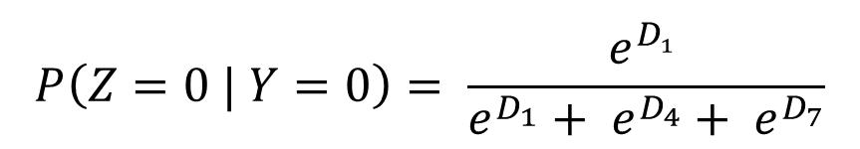
Simulating Mixed Data
Y
Discrete Child
$$P\left(Z=0 | Y=0\right)= \frac{e^{D_{1}^{}}}{e^{D_{1}}+ e^{D_{4}}+ e^{D_{7}}}$$
 | Y = 0 | Y = 1 | Y = 2
Z = 0 | D₁ | D₂ | D₃
Z = 1 | D₄ | D₅ | D₆
Z = 2 | D₇ | D₈ | D₉
Z

Slide 37
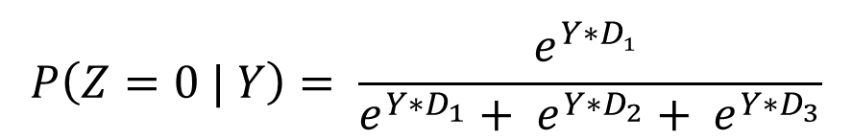
Simulating Mixed Data
Y
Discrete Child
$$P\left(Z=0 | Y\right)= \frac{e^{{Y∗D}_{1}^{}}}{e^{{Y∗D}_{1}}+ e^{{Y∗D}_{2}}+ e^{Y∗D_{3}}}$$
Z
 | Y
Z = 0 | D₁
Z = 1 | D₂
Z = 2 | D₃
Notes:
for cd edge parameters we draw a vector three values uniformly from [0,1] and shift and scale the values so they sum to zero and the largest parameter is equal to the edge weight;
for dd edge parameters we draw one vector of three values as with cd edges and set the rows of the matrix as the three permutations of this vector.

Slide 38
Simulation Parameters
Number of Variables | {50,500}
Sample Size | {200,500,1000}
Number of Edges | Normally Distributed, approximately 2x the number of Variables
Number of Trials | 10
Alpha Parameters for FCI Algorithms | {.001,.01,.05,0.1}
Lambda Parameters for MGM | {.1,.15,.25}
Probability Cutoffs for BCCD | {0.25,0.5,0.75}
Latent Variables | {5,20}
Notes:
Graphs = scale free graphs, generated using the method described by Bollobas et al., full details can be found in that paper

Slide 39
Bayesian Constraint-Based Causal Discovery (BCCD) Adjacency Search
Start with fully connected graph
For each edge, take a subset S of up to K variables in the neighborhood of the edge
For each DAG of this subset, compute
P(G | D_{S})
Compute Probability of each Independence Statement I and assign p(I) = max (new p(I), old p(i))
Accept independencies with probability greater than a threshold

Slide 40
Bayesian Constraint-Based Causal Discovery (BCCD) Orientations
Orient edges in order of decreasing probability until orientation threshold is reached

